Slide 1


Olisamedua Okafor
September 9th, 2023

Slide 2

Outline
Executive Summary
Introduction
Methodology
Results
Conclusion
Appendix

Slide 3
Executive Summary
Overview of Methodologies: A comprehensive summary of the techniques and approaches used throughout the project.
Data Collection Methods: Utilized SpaceX API and web scraping techniques to gather relevant data.
Data Preprocessing and EDA: Conducted data wrangling to clean and format the raw data, followed by Exploratory Data Analysis to uncover trends and patterns.
Machine Learning Models: Employed various classification algorithms, including decision trees, to make predictions.
Results Summary: A consolidated report of all findings, analyses, and predictions made during the project.
Key Determinants of Success: Identified grid fins, launch sites, and payload mass as significant factors contributing to successful launches.
Predictive Modeling: Utilized a Decision Tree Classifier to accurately predict the outcomes of SpaceX launches.

Slide 4
Introduction
The first stage of the rocket is a critical factor for successful launches.
Being considerably larger and more expensive than the second stage, the first stage represents a significant investment.
SpaceX gains a cost advantage over other providers by reusing the first stage.
Accurately predicting the success of each first stage landing could result in substantial cost savings.
Therefore, my objectives are as follows:
Identify the key factors that contribute to the success and cost of each launch.
Utilize this information to predict the outcomes of future SpaceX launches.

Slide 5

Section 1

Slide 6
Methodology
Executive Summary
Data collection methodology:
Acquired comprehensive datasets through web scraping techniques and by leveraging the SpaceX API for targeted data extraction.
Perform data wrangling
Eliminated extraneous data, addressed missing values, and engineered a new column specifically for analysis.
Perform exploratory data analysis (EDA) using visualization and SQL
Perform interactive visual analytics using Folium and Plotly Dash
Perform predictive analysis using classification models
Divide the data into training and test sets, then calculate the performance score of each model to identify the best-fitting one.

Slide 7
Data Collection
Data was gathered from two primary sources: the SpaceX API (https://api.spacexdata.com/v4/rockets/) and a Wikipedia page listing Falcon 9 and Falcon Heavy launches (https://en.wikipedia.org/wiki/List_of_Falcon_9_and_Falcon_Heavy_launches). The collection methods employed API calls for SpaceX data and web scraping techniques for the Wikipedia information.

Slide 8
Data Collection – SpaceX API
SpaceX provides a public API that allows for the convenient retrieval and utilization of data.
The API was utilized as outlined in the adjacent flowchart, after which the data was saved for long-term storage.
Source code: https://github.com/okaforoa/ibm-data-science-capstone/blob/main/Week%201/jupyter-labs-spacex-data-collection-api.ipynb
Retrieve and parse launch data from the SpaceX API
Restrict the dataset to only include launches conducted with Falcon 9 rockets
Address Missing Values in the Dataset

Slide 9
Data Collection - Scraping
• Information on SpaceX launches is also accessible through Wikipedia.
• Data is sourced from Wikipedia following a specific flowchart and is then stored for long-term use.
• Source code: https://github.com/okaforoa/ibm-data-science-capstone/blob/main/Week%201/jupyter-labs-webscraping.ipynb
Retrieve information from the Falcon 9 Launch Wikipedia page
Retrieve all column names from the HTML table header
Construct a DataFrame by extracting information from the launch-related HTML tables

Slide 10
Data Wrangling
Initially, I conducted exploratory data analysis (EDA) on the dataset.
Subsequently, we calculated the number of launches per site, the frequency of each orbit type, and the distribution of mission outcomes for each orbit category.
Ultimately, the 'landing outcome' label was generated from the 'Outcome' column.
Source code: https://github.com/okaforoa/ibm-data-science-capstone/blob/main/Week%201/labs-jupyter-spacex-data_wrangling_jupyterlite.jupyterlite.ipynb
EDA
Summarizations
Creation of Landing Outcome Label

Slide 11
EDA with SQL
SQL Queries Performed:
Retrieved names of unique launch sites involved in the space mission.
Identified the top 5 launch sites with names starting with 'CCA'.
Calculated the total payload mass carried by NASA (CRS) boosters.
Computed the average payload mass for boosters of version F9 v1.1.
Determined the date of the first successful ground pad landing.
Listed names of boosters successful in drone ship landings with payload mass between 4,000 and 6,000 kg.
Tallied the total number of successful and failed mission outcomes.
Named the booster versions that have carried the maximum payload mass.
Highlighted failed drone ship landings in 2015, including booster versions and launch site names.
Ranked the frequency of landing outcomes (e.g., Failure (droneship), Success (ground pad)) between June 4, 2010, and March 20, 2017.
Source Code: https://github.com/okaforoa/ibm-data-science-capstone/blob/main/Week%202/jupyter-labs-eda-sql-coursera_sqllite.ipynb

Slide 12
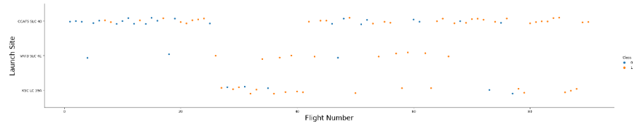
EDA with Data Visualization
To explore the data, various types of visualizations were employed, specifically scatterplots and bar plots.
Relationships between pairs of features were examined as follows:
Payload Mass and Flight Number
Launch Site and Flight Number
Launch Site and Payload Mass
Orbit and Flight Number
Payload and Orbit
Source code: https://github.com/okaforoa/ibm-data-science-capstone/blob/main/Week%202/jupyter-labs-eda-dataviz.ipynb

Slide 13
Build an Interactive Map with Folium
Utilized various mapping elements in Folium Maps, including markers, circles, lines, and marker clusters.
Markers: Used to pinpoint specific locations, such as launch sites.
Circles: Highlight areas around specific coordinates, like the NASA Johnson Space Center.
Marker Clusters: Group together events at each coordinate, such as multiple launches at a single launch site.
Lines: Indicate distances between two coordinates, aiding in spatial understanding.
Source Code: https://github.com/okaforoa/ibm-data-science-capstone/blob/main/Week%203/lab_jupyter_launch_site_location.jupyterlite.ipynb

Slide 14
Build a Dashboard with Plotly Dash
Developed an interactive dashboard using Plotly Dash.
Visualized total launches by specific sites through pie charts.
Illustrated the relationship between 'Outcome' and 'Payload Mass (Kg)' across different booster versions using scatter plots.
The dashboard code is accessible at this GitHub link.

Slide 15
Predictive Analysis (Classification)
Loaded the data into the environment using Numpy and Pandas libraries.
Transformed and preprocessed the raw data for analysis.
Split the dataset into training and testing sets for model validation.
Built multiple machine learning models and fine-tuned their hyperparameters using GridSearchCV.
Utilized accuracy as the evaluation metric for model performance.
Enhanced the model's performance through feature engineering and algorithm tuning.
Identified the best-performing classification model for our dataset.
For further details, refer to the GitHub Notebook.

Slide 16
Results
Launch Sites: SpaceX utilizes four different launch sites.
Initial Partners: The first launches were conducted for SpaceX itself and NASA.
Average Payload: The F9 v1.1 booster has an average payload capacity of 2,928 kg.
First Successful Landing: The first successful landing occurred in 2015, five years after the initial launch.
Above-Average Payloads: Many versions of the Falcon 9 booster successfully landed on drone ships while carrying payloads above the average.
Mission Success Rate: Nearly 100% of missions have been successful.
Failed Landings in 2015: Two booster versions—F9 v1.1 B1012 and F9 v1.1 B1015—failed to land on drone ships in 2015.
Improving Landing Success: The rate of successful landings has improved over the years.

Slide 17
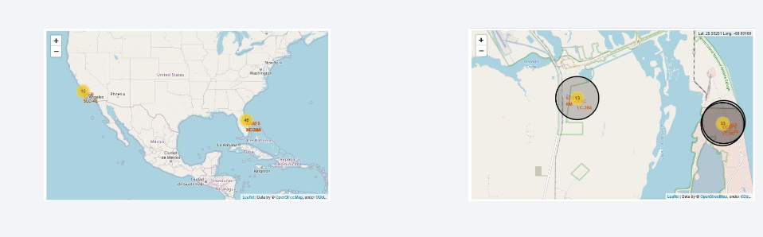
Results
Through interactive analytics, it was observed that launch sites are typically located in safe areas, often near the sea.
These sites are also supported by robust logistical infrastructure.
A majority of launches occur at launch sites located on the East Coast.

Slide 18

Section 2

Slide 19
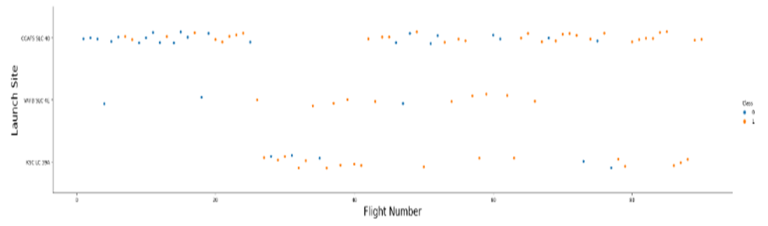
Flight Number vs. Launch Site
Analysis of the plot reveals a positive correlation between the volume of flights at a launch site and its corresponding success rate.

Slide 20

Payload vs. Launch Site
The success rate of rockets launched from site CCAFS SLC 40 increases with greater payload mass.

Slide 21
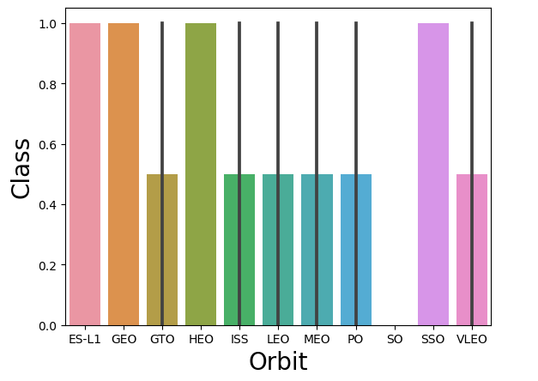
Success Rate vs. Orbit Type
Based on the graph, it is evident that ES-L1, GEO, HEO, SSO, and VLEO exhibit the highest success rates.

Slide 22

Flight Number vs. Orbit Type
The chart below illustrates the relationship between Flight Number and Orbit Type. It becomes apparent that for missions targeting Low Earth Orbit (LEO), there is a correlation between the number of flights and mission success. However, for Geosynchronous Transfer Orbit (GTO) missions, the data suggests no discernible relationship between the number of flights and the likelihood of mission success.

Slide 23
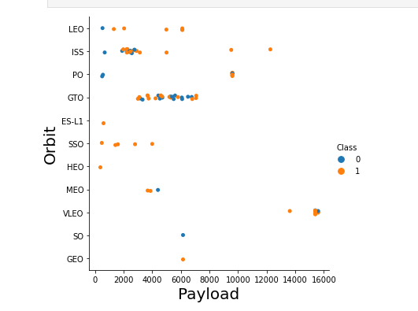
Payload vs. Orbit Type
We observe that for heavy payloads, successful landings are more frequent in PO, LEO, and ISS orbits.

Slide 24
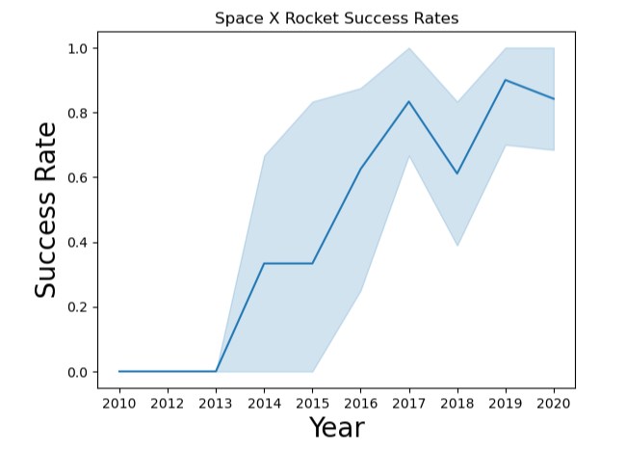
Launch Success Yearly Trend
Based on the graph, it is evident that the success rate has consistently risen from 2013 through 2020.

Slide 25
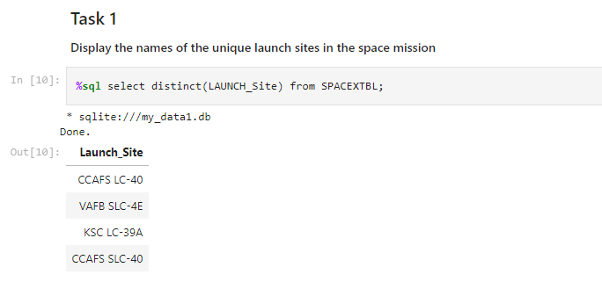
All Launch Site Names
We employed the 'DISTINCT' keyword to display only unique launch sites from the SpaceX dataset.

Slide 26
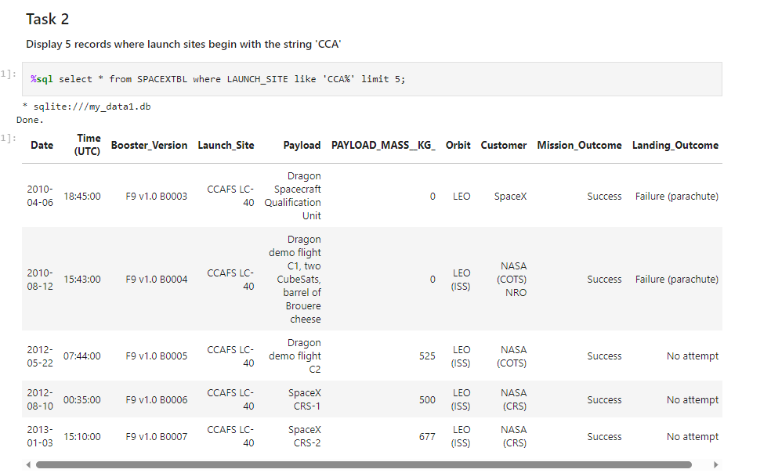
Launch Site Names Begin with 'CCA'
We executed the aforementioned query to retrieve and display five records featuring launch sites whose names begin with 'CCA'.

Slide 27
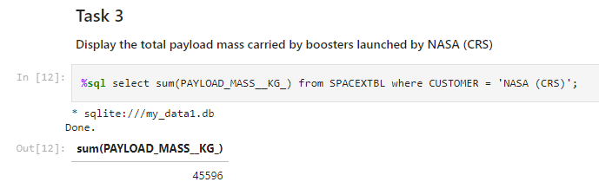
Total Payload Mass
We determined the total payload capacity of NASA's rocket boosters to be 45,596 units, as obtained through the following query:

Slide 28
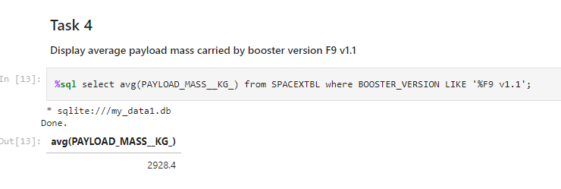
Average Payload Mass by F9 v1.1
We calculated the average payload mass carried by booster version F9 v1.1 as 2928.4

Slide 29
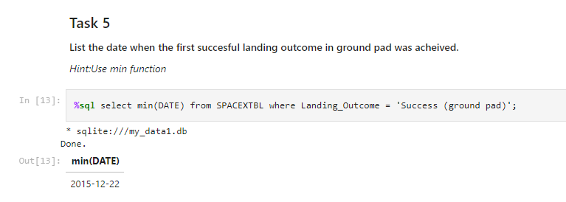
First Successful Ground Landing Date
We noted that the first successful landing on a ground pad took place on December 22, 2015.

Slide 30
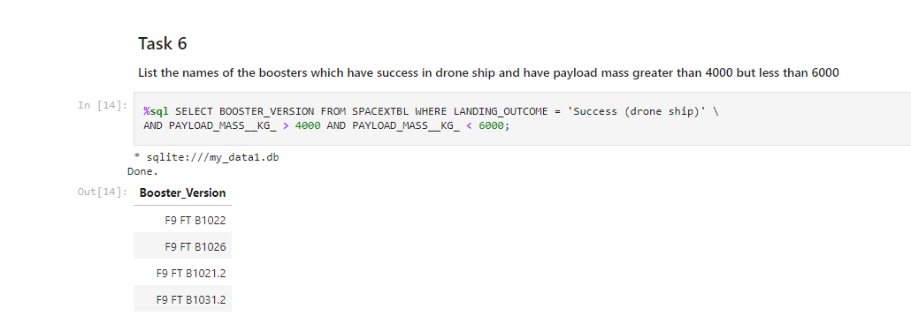
Successful Drone Ship Landing with Payload between 4000 and 6000
We employed the WHERE clause to filter boosters that have successfully landed on drone ships. Additionally, we used the AND condition to further refine our search to include only those landings with a payload mass between 4,000 and 6,000 kilograms.

Slide 31
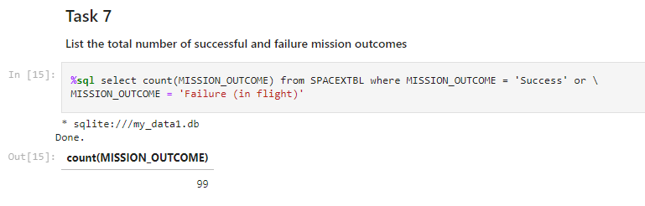
Total Number of Successful and Failure Mission Outcomes
We employed the wildcard character '%' in our SQL query to filter records where the Mission_Outcome was either a success or a failure.

Slide 32
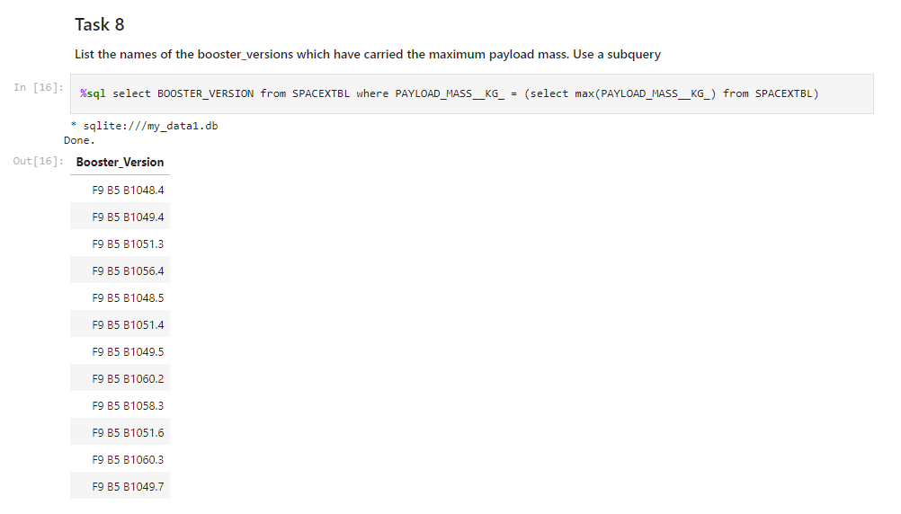
Boosters Carried Maximum Payload
We identified the booster that has carried the maximum payload by utilizing a subquery within the WHERE clause along with the MAX() function.

Slide 33
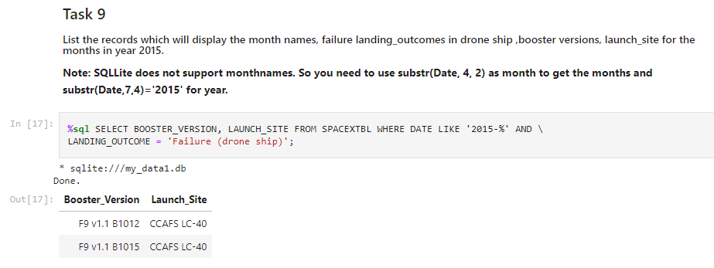
2015 Launch Records
We employed a combination of SQL conditions—specifically the WHERE clause, LIKE operator, AND, and BETWEEN— to filter for unsuccessful drone ship landings, corresponding booster versions, and launch site names for the year 2015.

Slide 34
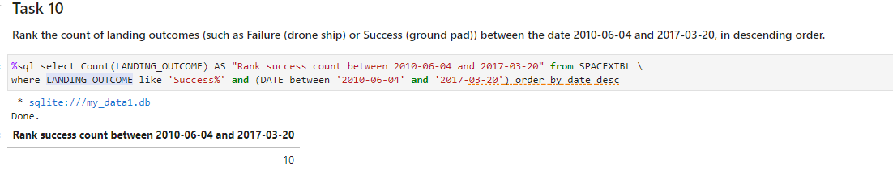
Rank Landing Outcomes Between 2010-06-04 and 2017-03-20
We extracted the 'Landing Outcomes' and their respective counts from the dataset. To focus on a specific time frame, we employed the WHERE clause to filter records between March 20, 2010, and June 4, 2010. Subsequently, we used the GROUP BY clause to aggregate the data based on the landing outcomes. Finally, the ORDER BY clause was applied to sort the grouped landing outcomes in descending order.

Slide 35

Section 3

Slide 36
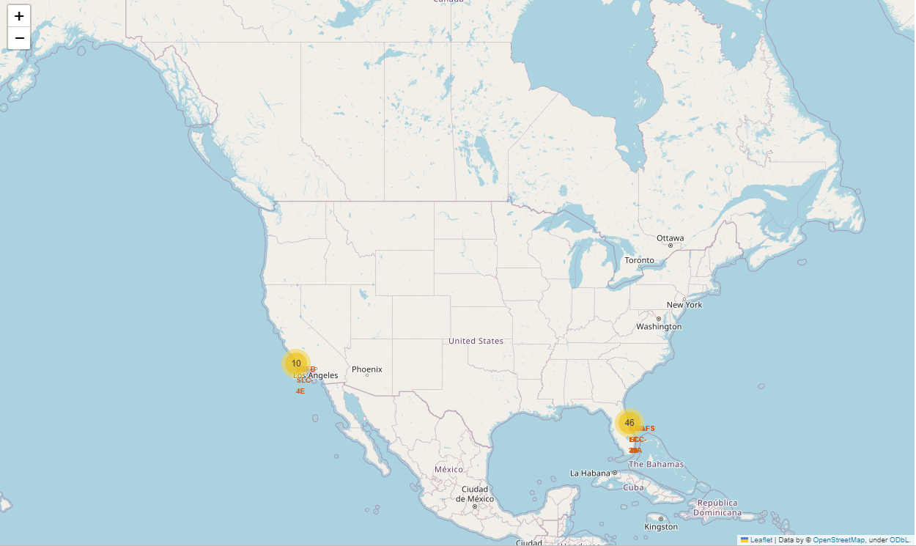
All Launch Sites in the United States
According to the map, SpaceX's launch sites are situated at Cape Canaveral's Space Launch Complex 40 (SLC-40) in Florida, USA, as well as at Vandenberg Space Force Base in California, USA.

Slide 37
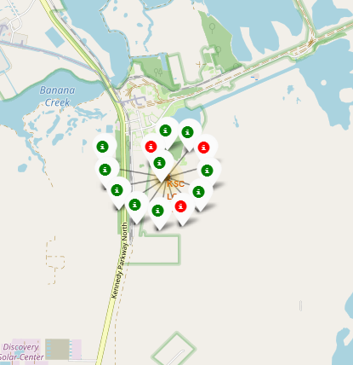
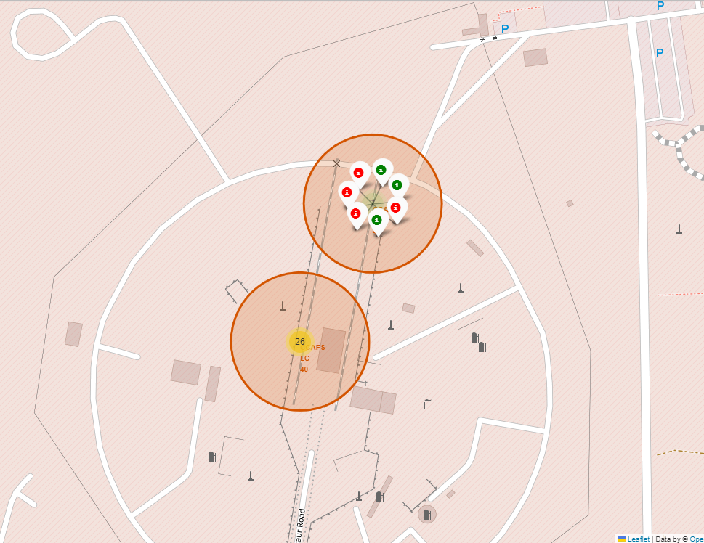
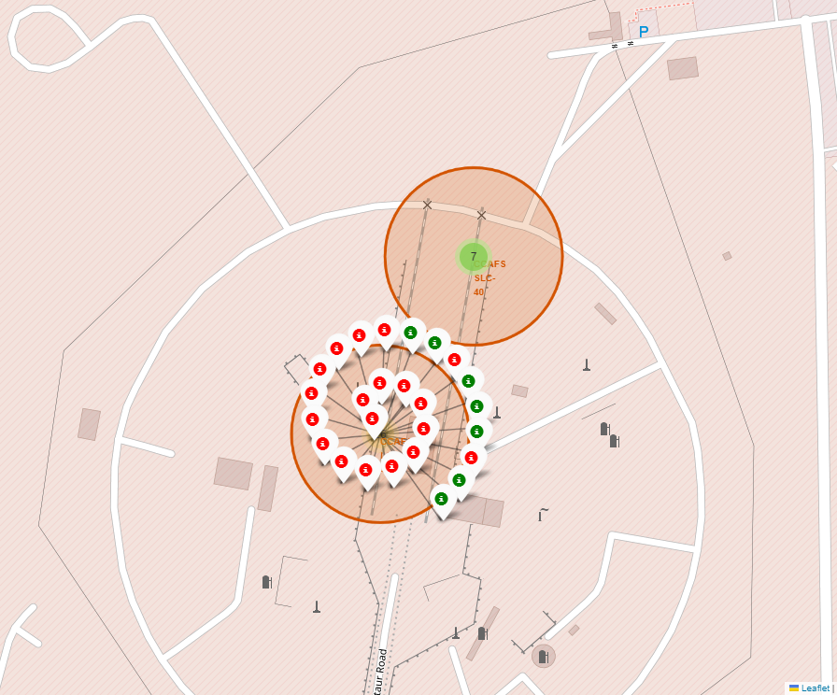
Color-coded markers indicating launch site locations
The green markers indicates successful launches, while the red markers signifies failures.
Florida Sites:

Slide 38
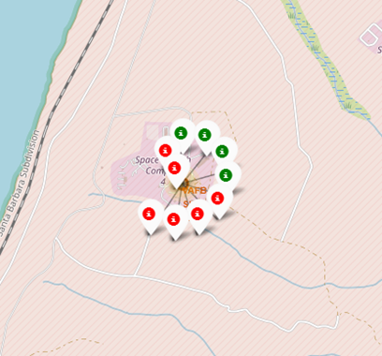
Color-coded markers indicating launch site locations
The green markers indicates successful launches, while the red markers signifies failures.
California Site:

Slide 39

Distance from Launch Site to Nearby Landmarks

Slide 40

Section 4

Slide 41
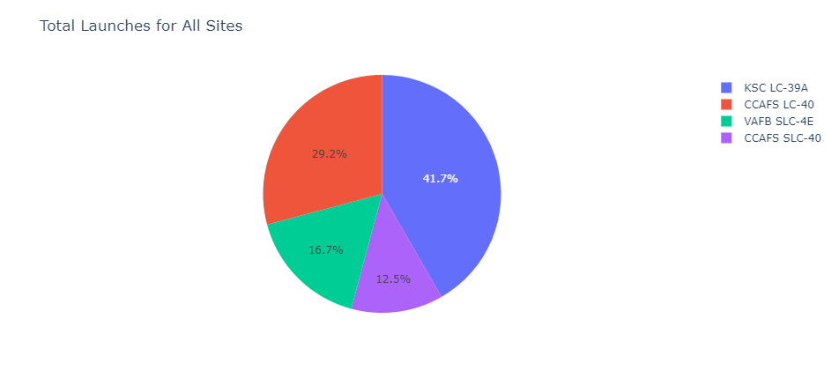
Pie Chart Illustrating the Success Rates of Various Launch Sites
KSC LC-39A had the most successful launches.

Slide 42
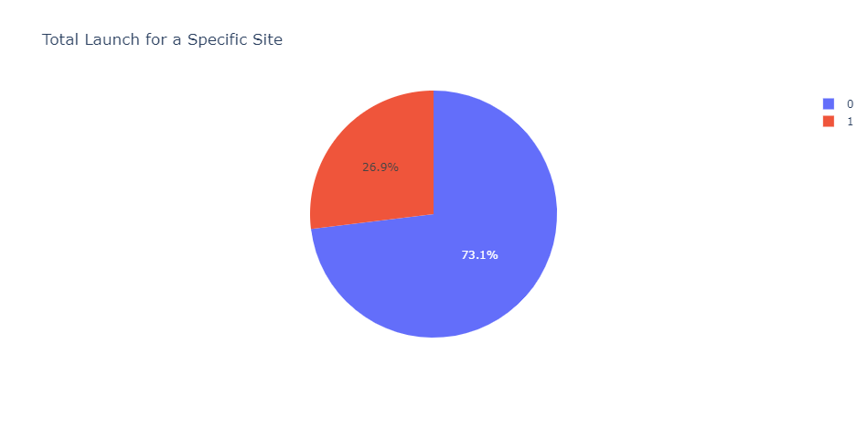
Pie Chart Illustrating the Launch Site with the Highest Success Rate for Rocket Launches
KSC LC-39A had a 73.1% successful rate and a 26.9% failure rate.

Slide 43
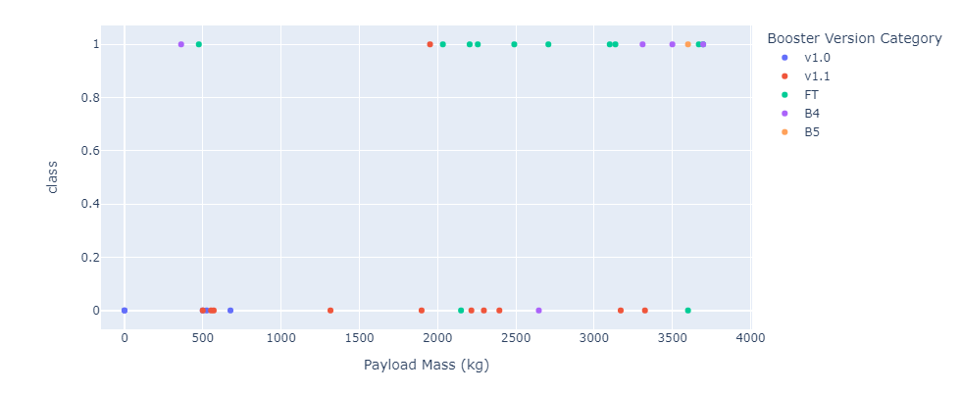
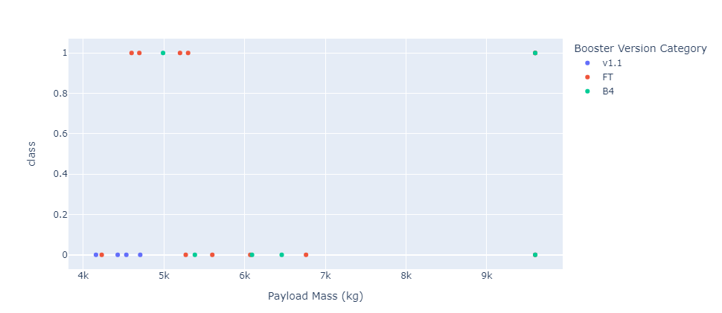
Interactive Scatter Plot Comparing Payload Weight to Launch Outcome Across All Launch Sites, Featuring a Range Slider for Payload Selection
The success rate for payloads with lower weight is higher compared to those with heavier weight.

Slide 44

Section 5

Slide 45
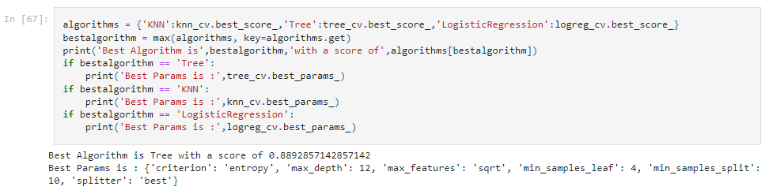
Classification Accuracy
The decision tree classifier emerges as the model delivering the highest level of classification accuracy.

Slide 46
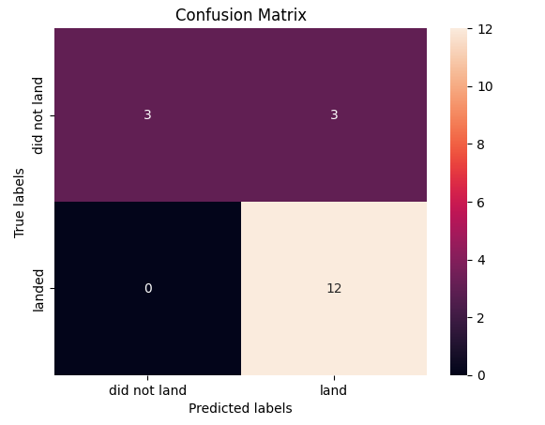
Confusion Matrix
The confusion matrix for the Decision Tree classifier indicates that the model is generally capable of differentiating between various classes. However, a significant issue lies in its tendency to produce false positives—specifically, instances where the classifier incorrectly labels unsuccessful landings as successful.

Slide 47
Conclusions
We can conclude that:
A higher number of flights at a launch site correlates with a greater launch success rate.
The overall launch success rate has been on the rise from 2013 to 2020.
The orbits ES-L1, GEO, HEO, SSO, and VLEO have the highest success rates.
KSC LC-39A stands out as the launch site with the most successful launches.
The Decision Tree Classifier is the most effective machine learning algorithm for predicting launch success.

Slide 48


